Slide 1
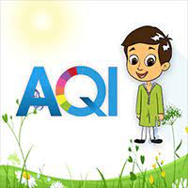
Analysis on Air quality Index in india
1.Nikita Nannaware
2. Satyaveni Nadiminti
3.Narendra Jadhav

Slide 2
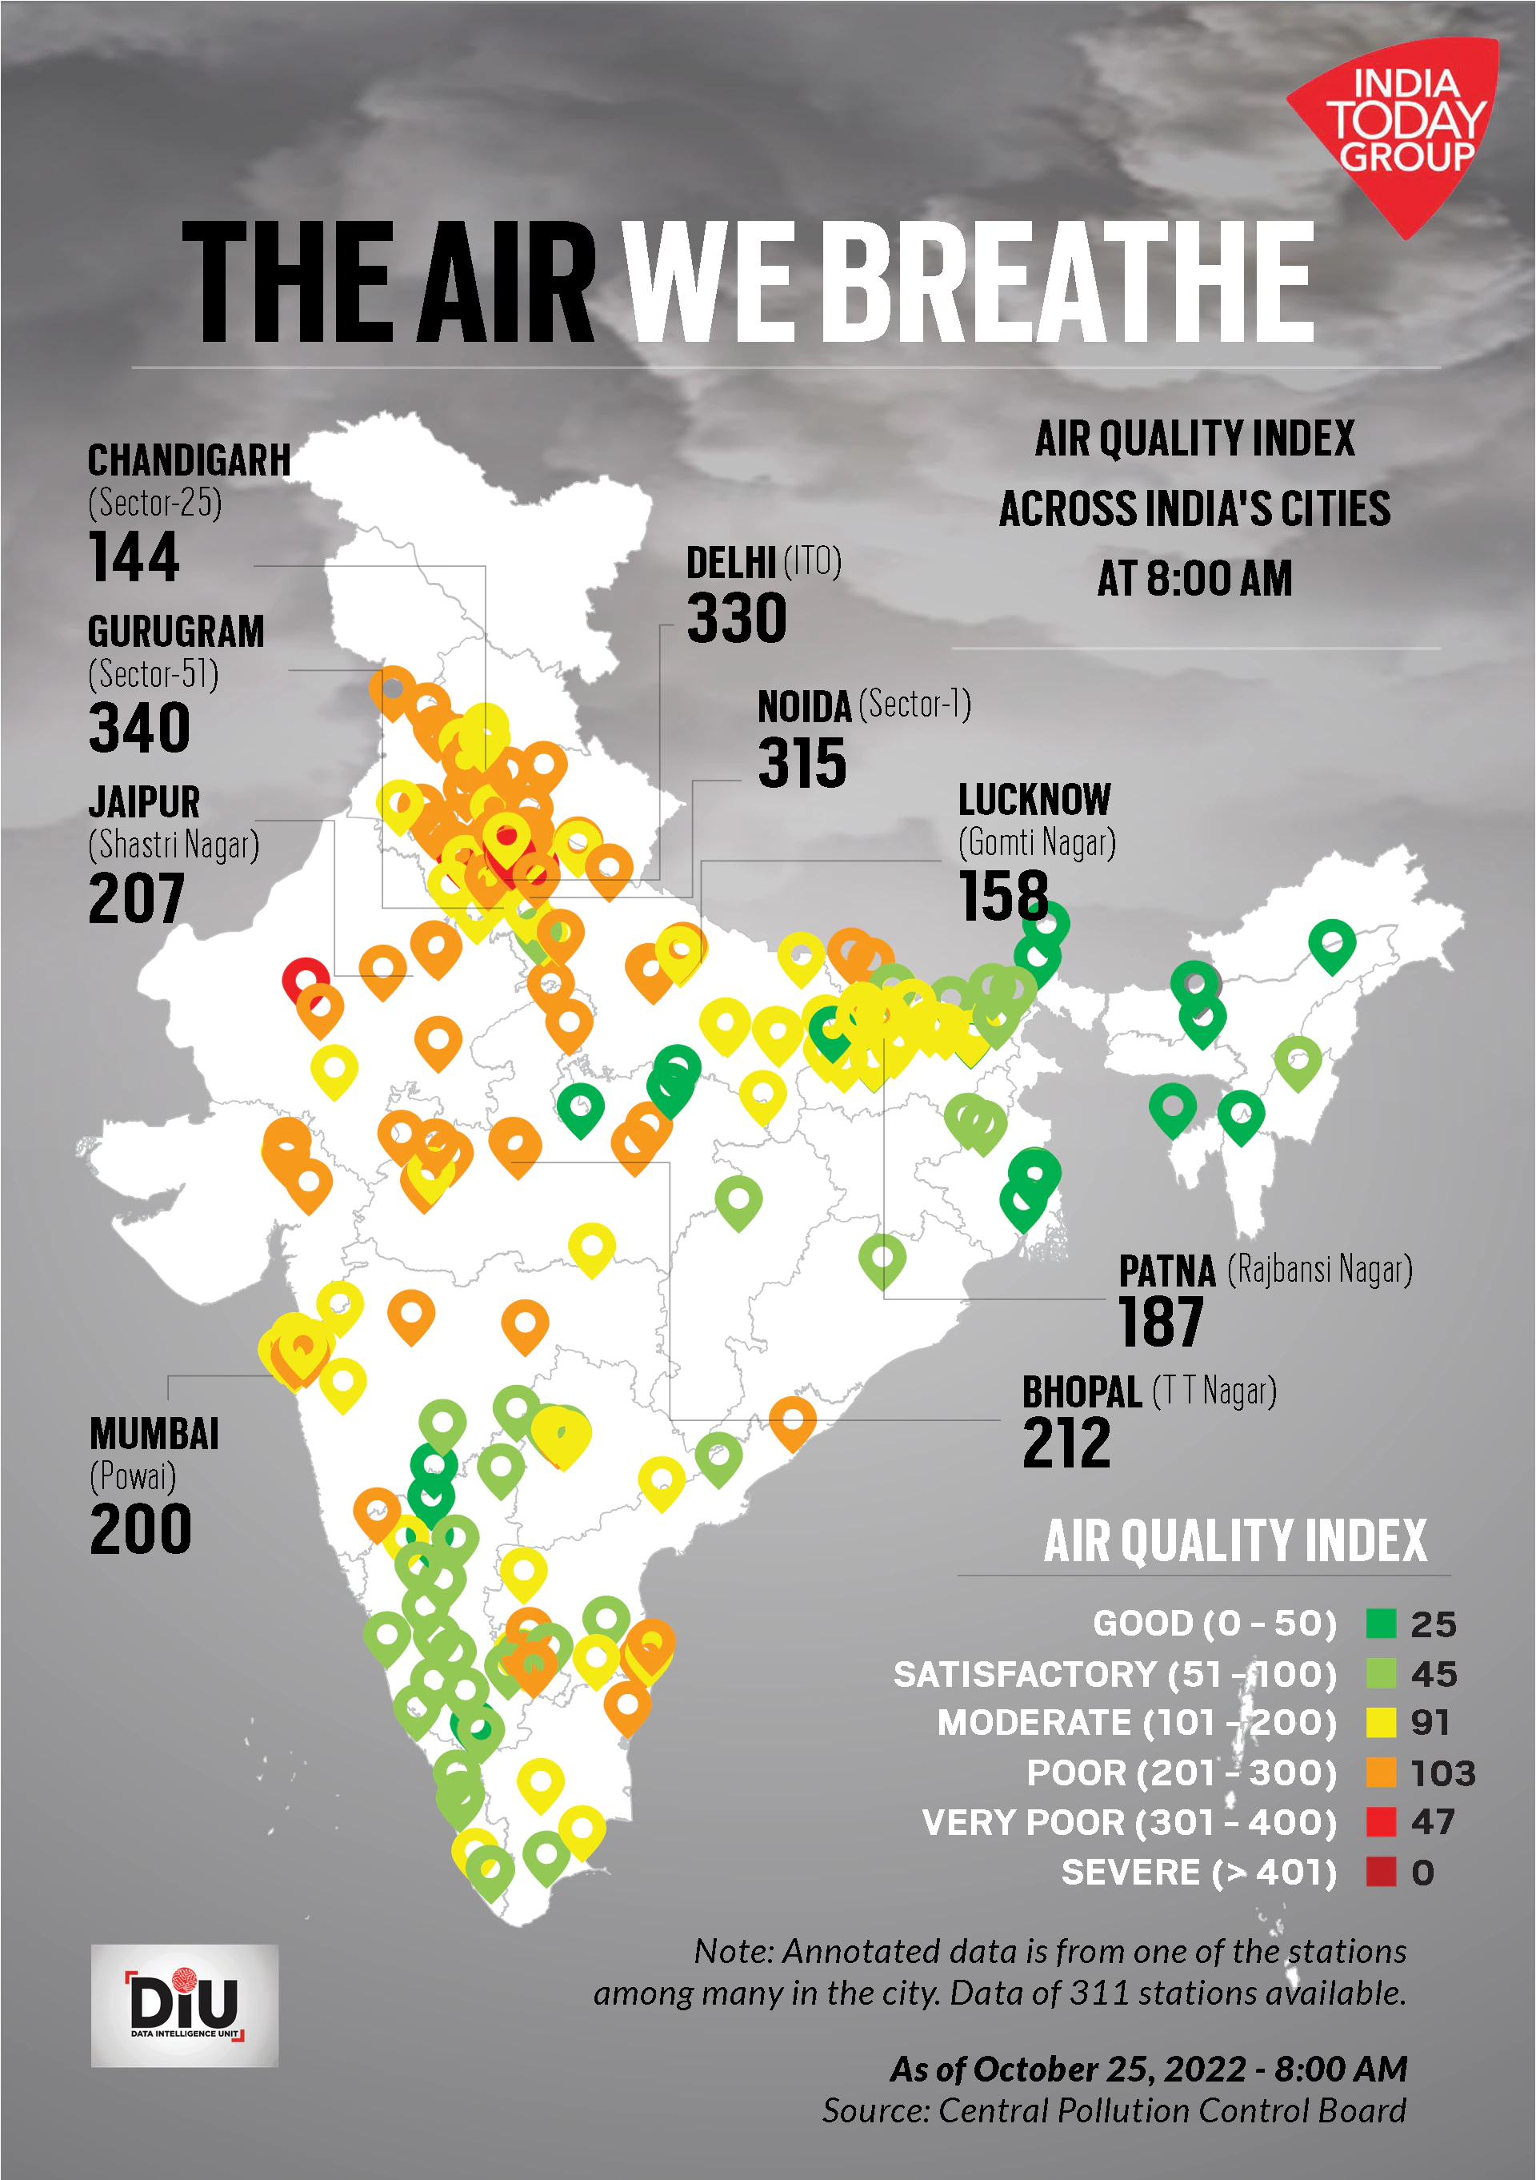
Datasets:
1.Stations
2.Station_hour
3.Station_day
4.City_hour
5.City_day
Data Source: https://www.kaggle.com/code/eda-on-aqi

Slide 3
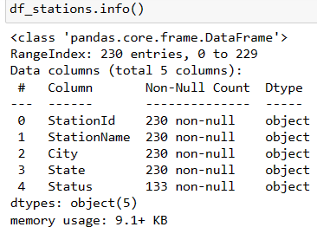
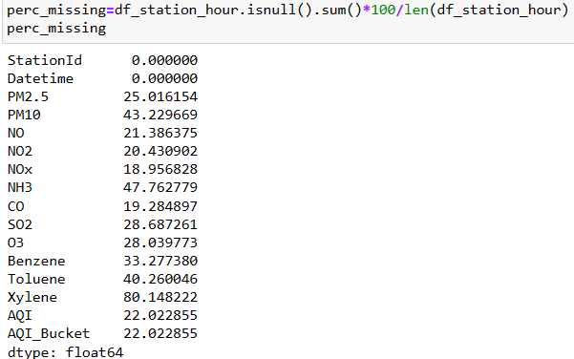
Eda on Datasets: Info About The Dataset: 1.Status Columns Contains Null Values And Not An Important Column So We Dropped That Column. 2. After Getting Percentage Of Missing Values In Station_hour Table We Dropped The Xylene(80%) And Nh3(47%) Because Of Higher Percentage Of Missing Value

Slide 4
AQI:
Air Quality Index (AQI) is a standardized summary measure of ambient air quality used to express the level of health risk related to particulate and gaseous air pollution.
There are six AQI categories, namely Good, Satisfactory, Moderately polluted, Poor, Very Poor, and Severe.

Slide 5
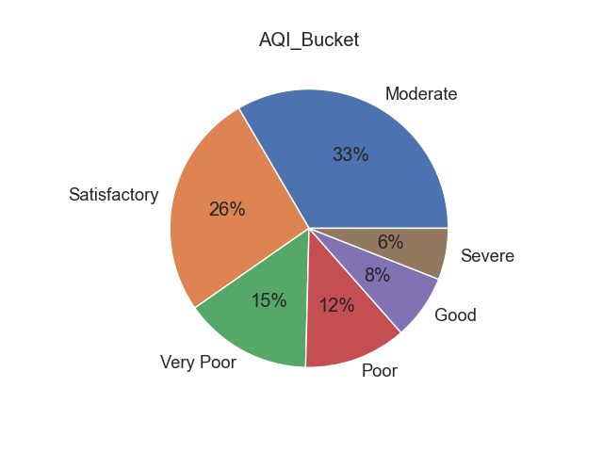
2.Pie Chart: observations: 1. The Air Quality Index (AQI) In India Is Divided Into Five Levels (Very Good: 0-100; Good: 101-200; Moderate: 201-300; Poor: 301-400; And Very Poor: 401-500) With A Yardstick That Runs From 0 To 500 So We Can See Here Higher Amount Of AQI Is Moderate And Satisfactory With 26% And Lastly Severe With 6%.

Slide 6
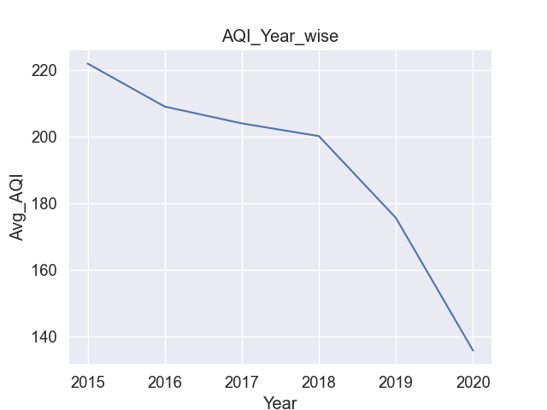
1. Line Plot For Air Quality Index In Each Year by Average AQI Value: 2. The higher the AQI value, the greater the level of air pollution and the greater the health concern. 3.Here 2015 Has Highest AQI Value And In 2020 It Has Lowest AQI Value Because Of Low Pollution.
AQI FOR EACH YEAR

Slide 7
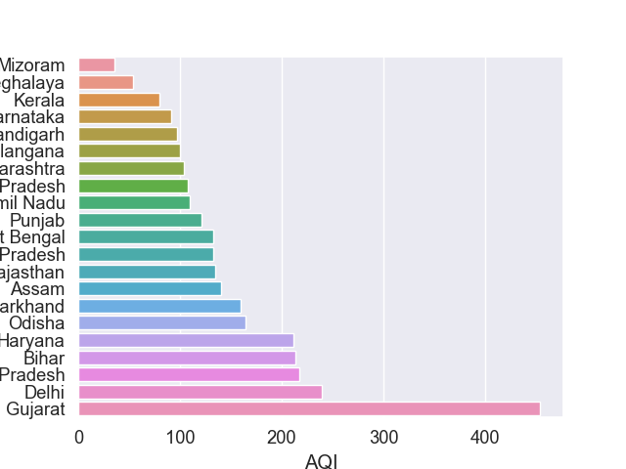
Observations: 1.Gujrat Have The Highest Range Of Aqi Value (Most Polluted State) 2.Delhi Have The Second Highest Aqi Value 3.Mizoram Have The Lowest Range Of Aqi Value(lower Polluted State)
State vs AQI Bar plot

Slide 8
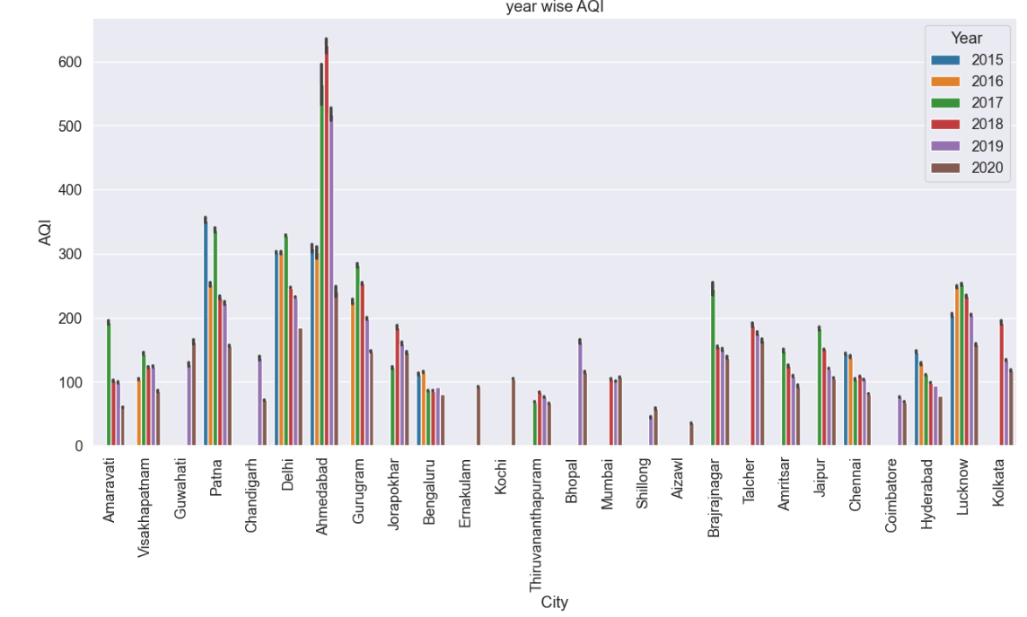
Observations:
1.This Plot Shows The Year Wise AQI For Every City
2.For Ahemedabad AQI Value In 2018 Is Highest With Respect To Other Years.

Slide 9
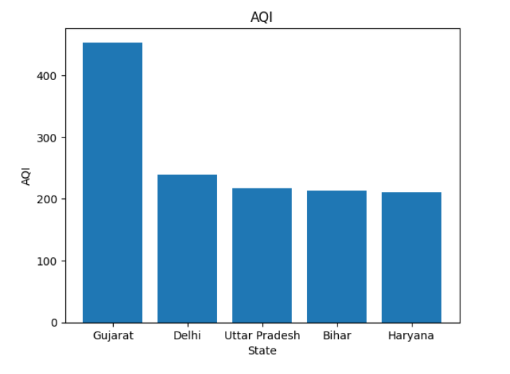
Observations: 1.Gujarat Have The Highest Aqi(most Polluted) State Value. 2.Delhi Have The Second Highest Aqi Value
Top Five State With Highest AQI

Slide 10
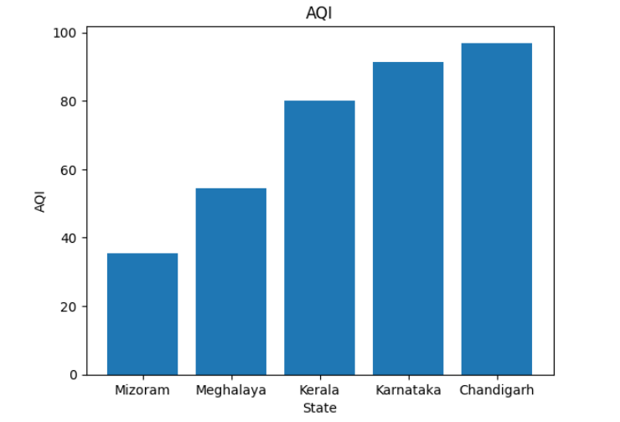
Observations: 1.Mizoram Have The Lowest Aqi(least Polluted) State Value. 2.Meghalaya Is The Second Least Polluted State
BOTTOM FIVE STATE WITH LOWER AQI

Slide 11
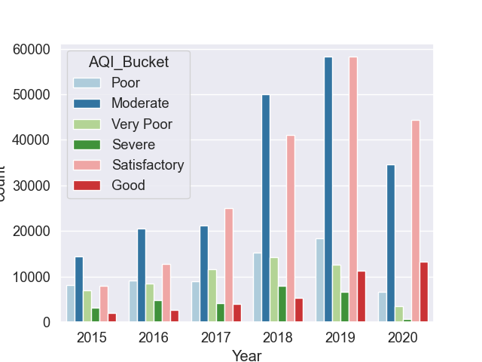
Observations: 1.So Here We Can Observed That In Every Year Moderate Level And Satisfactory Level Of AQI Is Higher. 2.In 2019 The Level of AQI Is Higher As Compared To Other Years.
AQI Categories with Year

Slide 12
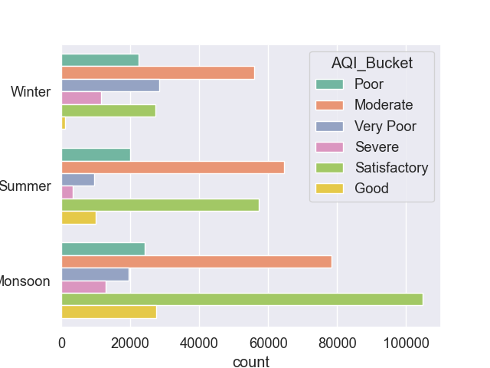
Season Wise AQI Category
OBSERVATIONS:
1.This Plot Represents The Season-wise Category Of AQI
By Winter, Spring, Summer, Autumn
2.Monsoon Has Higher Satisfactory Level AQI Range.

Slide 13
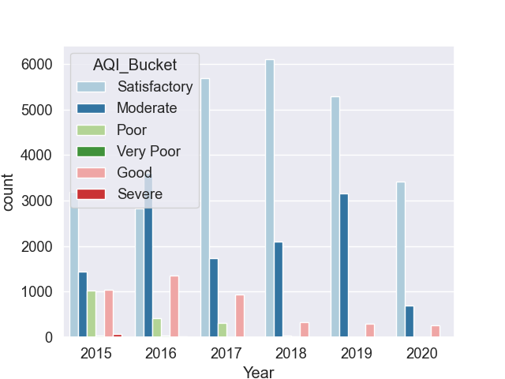
Observations: 1.Bengaluru City Has Satisfactory Range Of Aqi In Year 2018
Focusing On Bengaluru City AQI_Range

Slide 14
CONCLUSIONS
The higher the AQI value, the greater the level of air pollution and the greater the health concern.
Gujarat Have The Highest AQI (most Polluted) State Value.
Delhi Have The Second Highest AQI Value.
Mizoram Have The Lowest AQI(least Polluted) State Value.
2015 Has Highest AQI Value And In 2020 It Has Lowest AQI Value Because Of Low Pollution

Slide 15
THANK YOU….

